Slide 1
Analysis and Design of Algorithms
Session -24

Slide 2
Sum of subsets
Problem Definition: Given n distinct positive numbers wi, and m, find all subsets whose sums are m.
Explicit Constraints :
Xi = { j / j is an integer and 1 <= j <= n }
Implicit Constraints :
No two xi’s are same
Sum of the chosen weights must be equal to m.
To avoid generation of multiple instances of the same subsets)
We can formulate this problem using Fixed tuple or Variable tuples.

Slide 3
Variable- sized tuple
Ex:- n=4, ( w1, w2, w3, w4 )= ( 11,13, 24, 7 ), m=31.
  Solutions are ( 11, 13, 7 ) and ( 24, 7 )
Rather than representing the solution by wi ’s, we can represent by giving the indices of these wi
Now the solutions are ( 1, 2, 4 ) and ( 3, 4 ).
Different solutions may have different-sized tuples.
We use the following condition to avoid generating multiple instances of the same subset ( e.g., ( 1,2,4) and (1,4,2) )
  x_{i} < x_{i}+1

Slide 4
Subset Tree for n=4 (variable- sized tuple )
1
x₁=1
x₁=4
x₁=2
x₁=3
3
4
5
2
x₂=4
x₂=3
x₂=4
x₂=4
x₁=2
x₂=3
8
9
10
11
6
7
x₃=3
x₃=4
x₃=4
x₃=4
12
13
14
9
x₄=3
16
Nodes are numbered as in Breadth first search.

Slide 5
Fixed- sized tuple
In this method, each solution subset is represented by an n-tuple (x1,x2,…..x n).
x i = 0 if wi is not chosen and xi = 1 if wi is chosen
Ex:- n=4, ( w1, w2, w3, w4 )= ( 11,13, 24, 7 ), m=31.
  Solutions are ( 11, 13, 7 ) and ( 24, 7 )

Slide 6
Solutions are:
X=(1,1,0,1) and X=(0,0,1,1)

Slide 7
Subset Tree For n = 4 ( fixed – sized tuple )
x₁=1
x₁= 0
x₂=1
x₂= 0
x₂=1
x₂= 0
x₃=1
x₃= 0
x₄=1
x₄=0
0111
0001
1110
1011

Slide 8
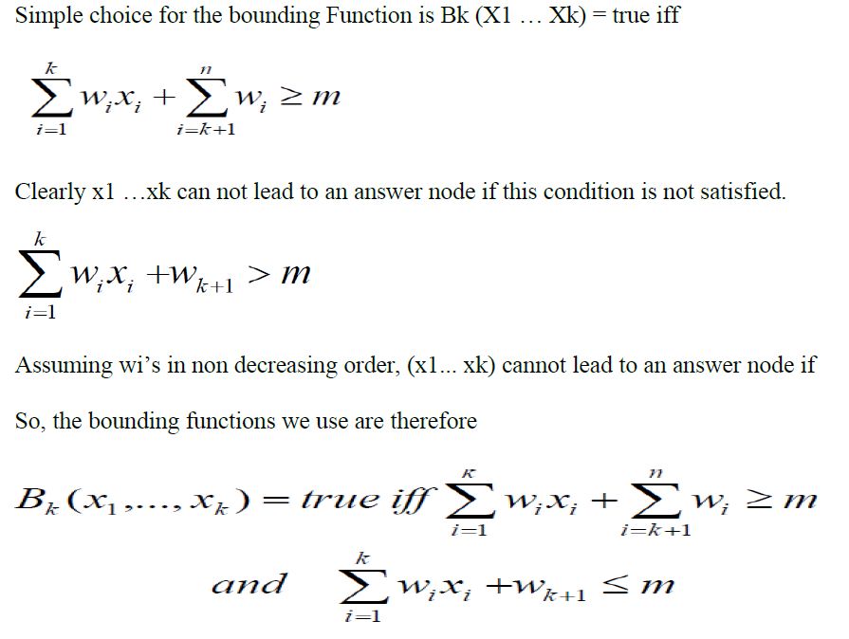
Boundary conditions of sum of subsets

Slide 9
_{Algorithm SumOfSub( s, k, r )}
// Find all subsets of w[ 1:n ] that sum to m
// It is assumed that w[1] ≤ m and ∑ wi ≥ m
{
_{x[ k ]=1; // left child}
if( s + w[k] = m ) then write( x[ 1: k ] ) ; // Subset found
else if ( s + s [ k ] + s[ k+1 ] ≤ m )
then SumOfSub( s+ w[k], k+1, r- w[k] )
// Generate right child and evaluate Bk
if ( ( s + r – w[ k ] ≥ m ) and ( s + w[ k+1 ] ≤ m ) ) then
{
_{x[ k ] = 0;}
} SumOfSub( s, k+1, r- w[k] ) ;
}

Slide 10
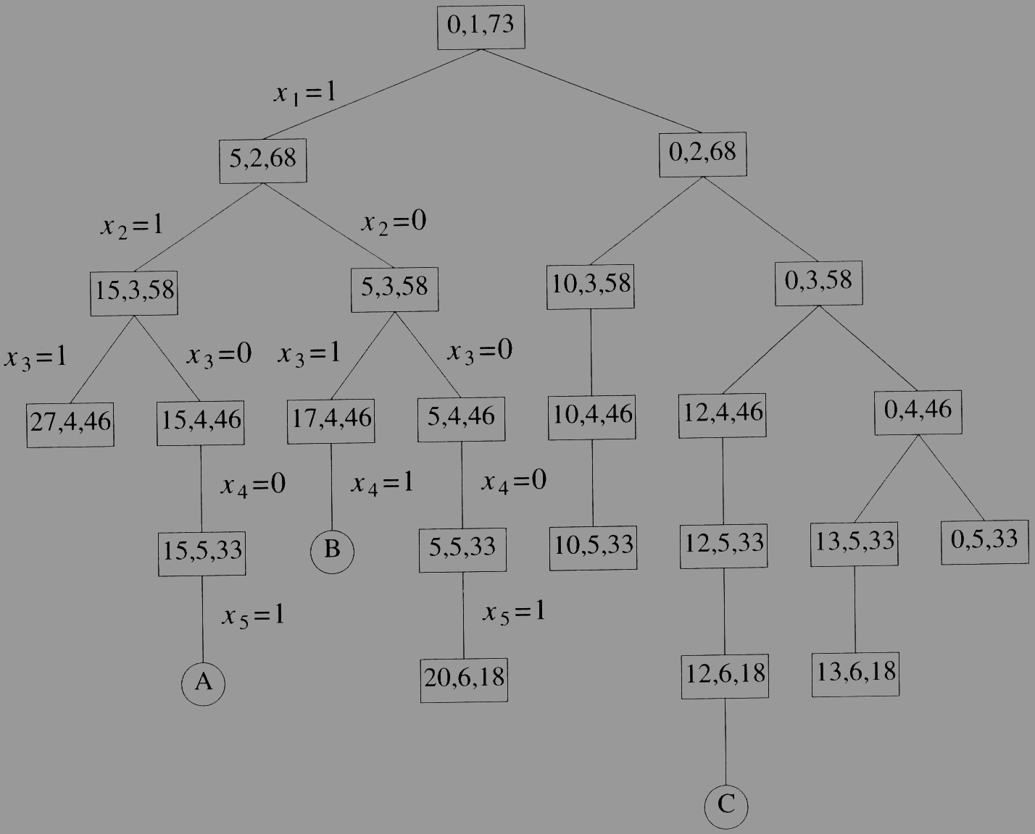
Ex:- n=6, m=30, w [ 1:6 ]= { 5,10,12,13,15,18 }
Portion of state space tree generated by SumOfSub. circular nodes indicate subsets with sums equal to m.
Example 7.6 (Figure 7.10)
  n=6, w[1:6]={5,10,12,13,15,18}, m=30

